Slide 1

Optimizing Business Websites
Rajesh Dorbala

Slide 2

Learning Outcomes
By the end of this session, you will be able to:
Know what is website optimization
Know why is website optimization important
Make website optimization work
Implement important optimization strategies
Optimize websites for search engines
Deploy website optimization tools
Create website optimization checklist

Slide 3

What is Website Optimization?
Website optimization is the process of using tools, advanced strategies, and experiments to improve the performance of your website, further drive more traffic, increase conversions, and grow revenue.
A holistic website optimization approach combines a variety of disciplines to make sure your website performs ideally in all areas:
SEO
Copywriting
Analytics
UX Design (Frontend)
Web Development (Backend)
CRO/Landing Page Optimization.

Slide 4
Why Is Optimization Important?
Internet has become a place where consumers make buying decisions
Internet has become a go-to destination to find information on local businesses
Internet has taken over the role of “asking a friend”
SEO generates targeted traffic from interested buyers
CRO can maximize the number of leads and sales generated through organic traffic

Slide 5
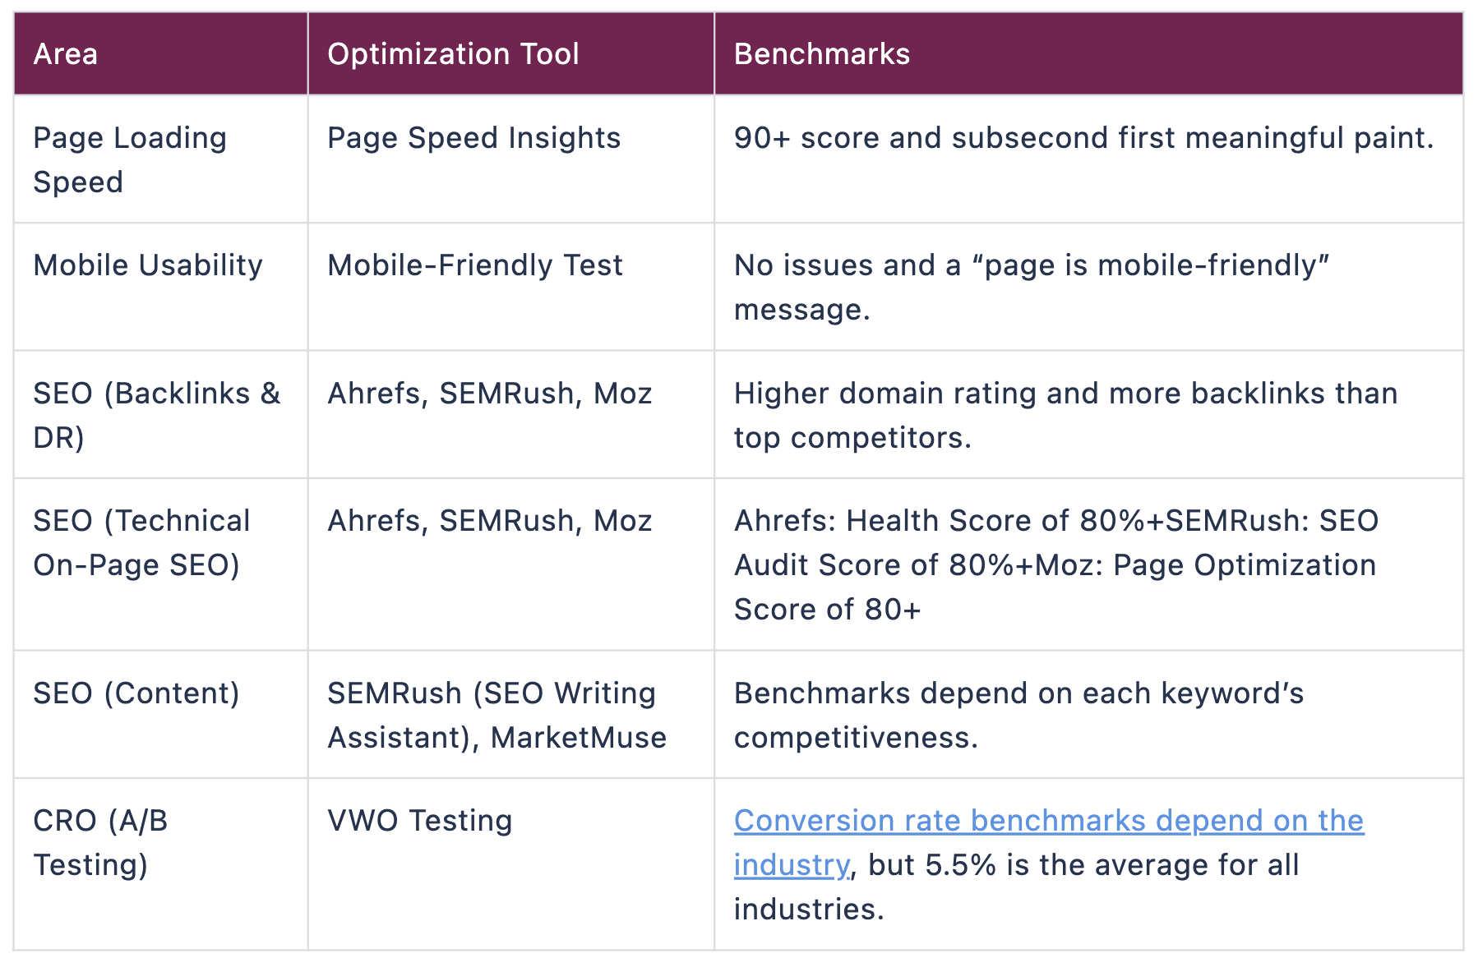
How Does Website Optimization Work?

Slide 6
6 Essential Website Optimization Strategies
Strategy | Tool
Optimizing the mobile experience | https://search.google.com/test/mobile-friendly
Improving page speed | https://tools.pingdom.com/
Search Engine Optimization | https://search.google.com/search-console/about
Tailoring website copy to drive conversion
A/B and Multivariate testing | https://vwo.com/tools/
Optimizing User Experience | https://vwo.com/tools/

Slide 7
SEO
Keyword research
On-Page SEO (Google Search Console, Ahrefs, Screaming Frog, MarketMuse)
UX: Improve page speed and experience (Pingdom)
Backlinking (Ahrefs)

Slide 8
Optimize your Site for Sales and Conversions
Understand your target market
Analyze current user-behavior
Improve usability
Use copywriting best practices
Use A/B testing to develop best landing pages
Implement cart abandonment and remarketing campaigns
Use push notifications to reach engaged users

Slide 9
Questions?
rajesh.19435@lpu.co.in

